Slide 1
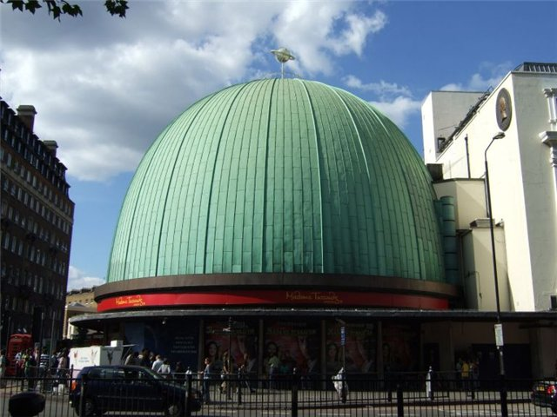
MADAME TUSSAUD`S
MUSEUM

Slide 2
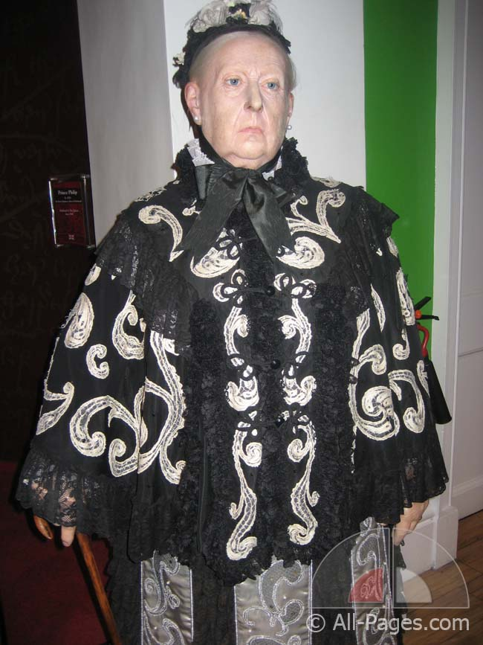
Marie
Tussaud

Slide 3
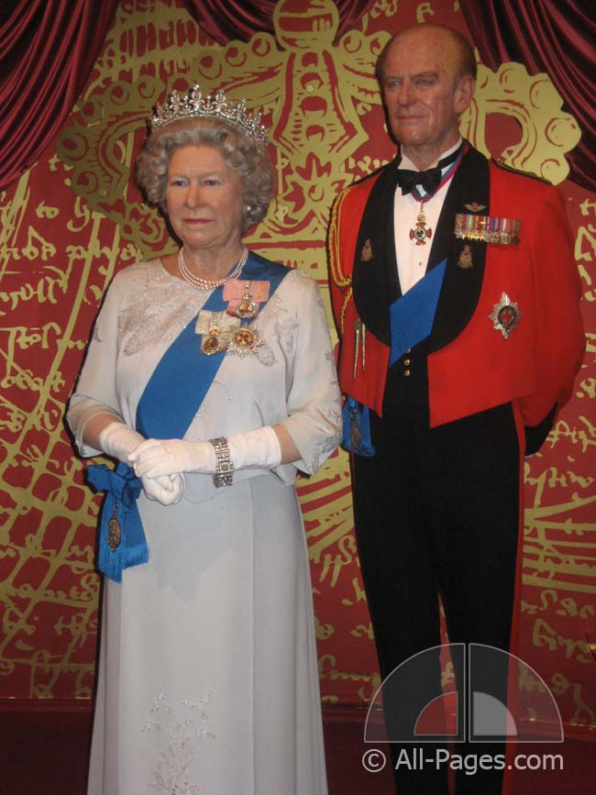
Elizabeth II and the Duke of Edinburgh

Slide 4
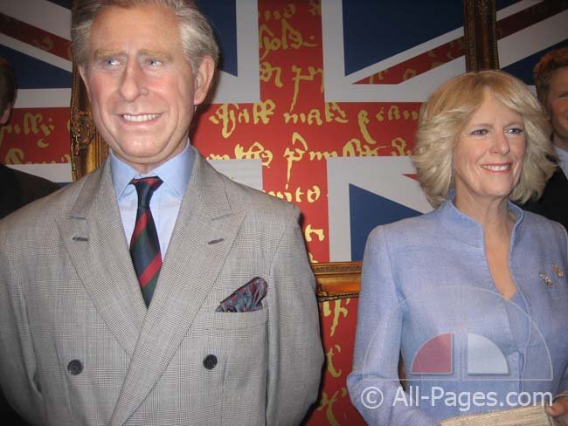
Prince Charles and his wife Camilla

Slide 5
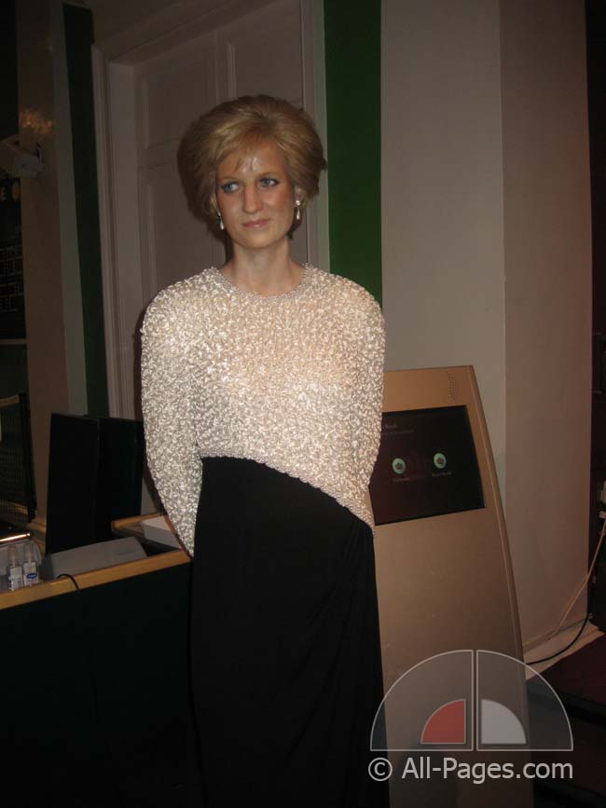
DIANA

Slide 6
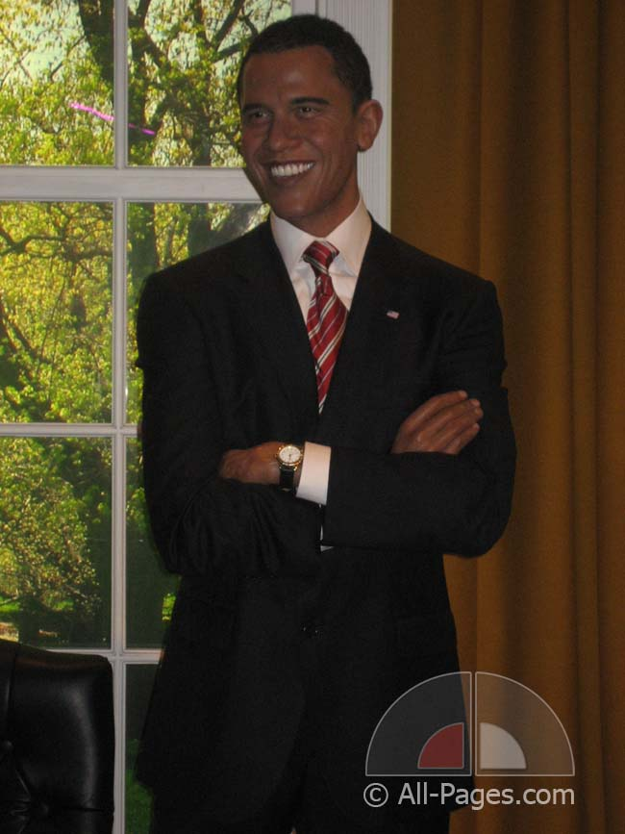
BARACK OBAMA

Slide 7
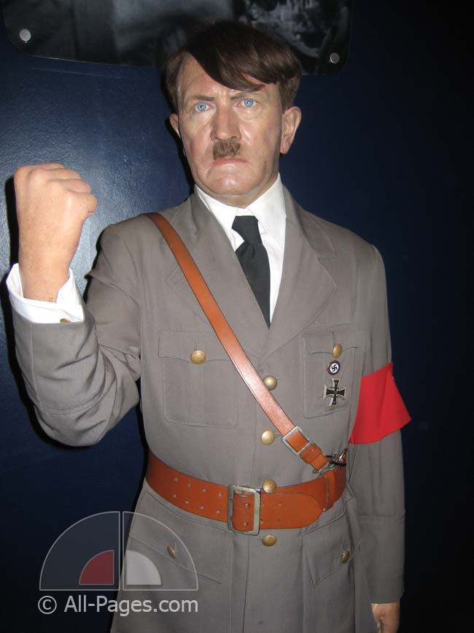
ADOLF HITLER

Slide 8
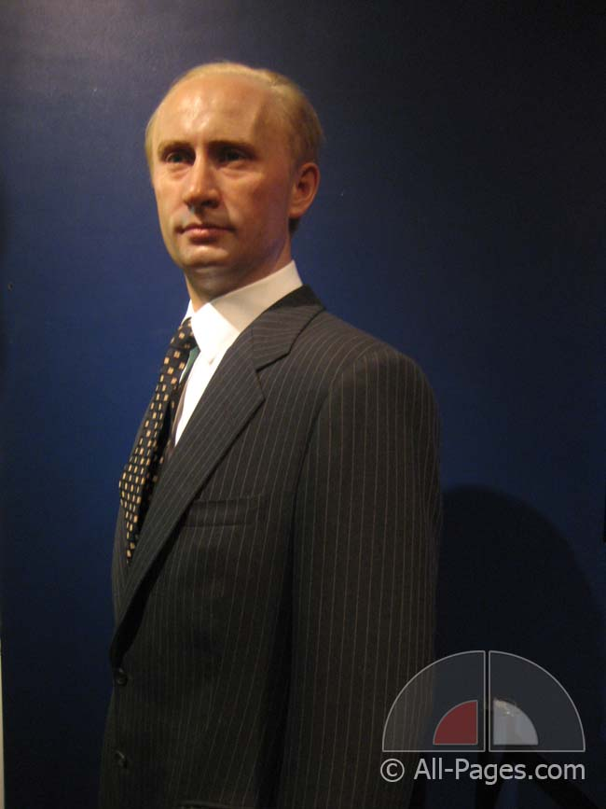
VLADIMIR PUTIN

Slide 9
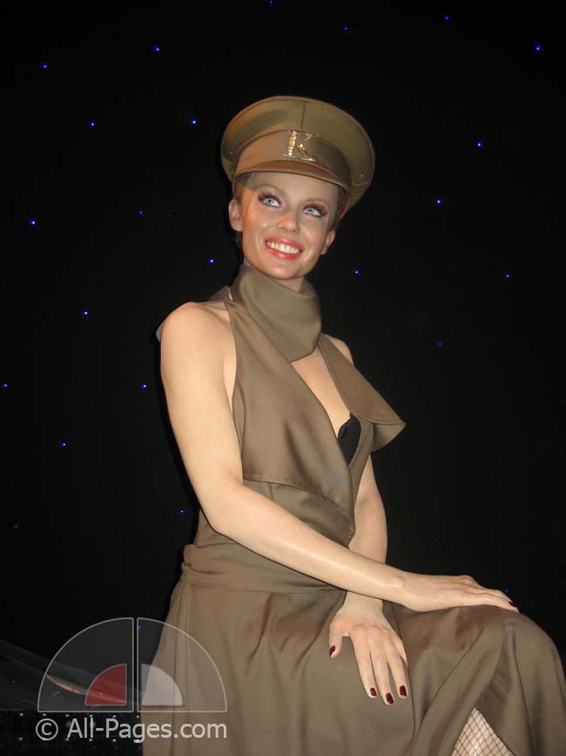
KYLIE MINOGUE

Slide 10
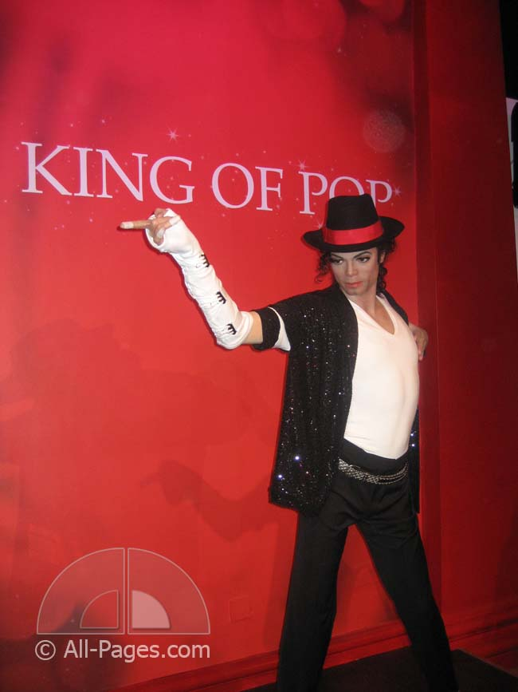
MICHAEL JACKSON

Slide 11
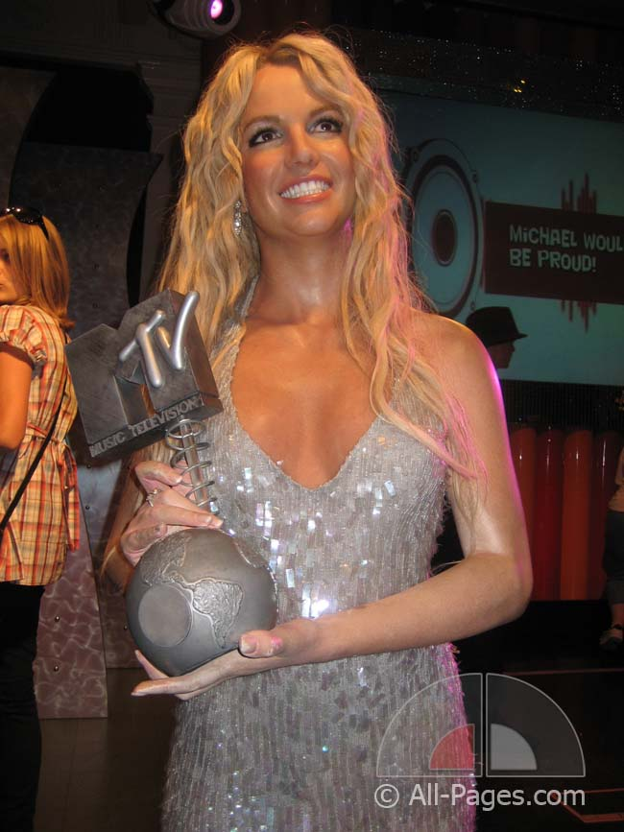
BRITNEY SPEARS

Slide 12
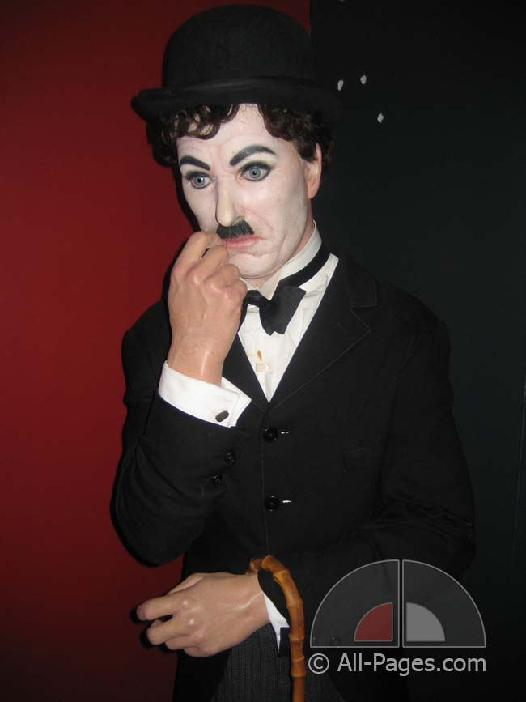
CHARLIE CHAPLIN

Slide 13
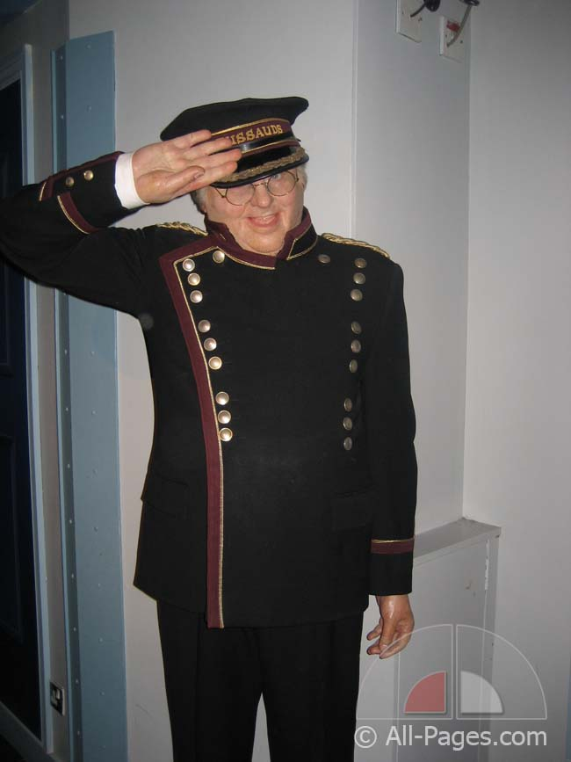
BENNY HILL

Slide 14
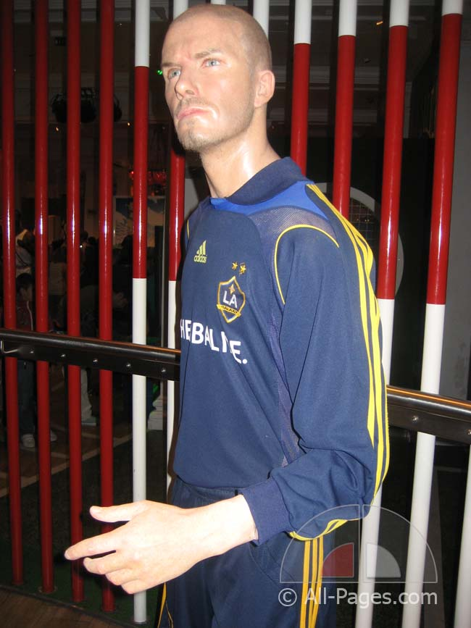
DAVID BECKHAM

Slide 15
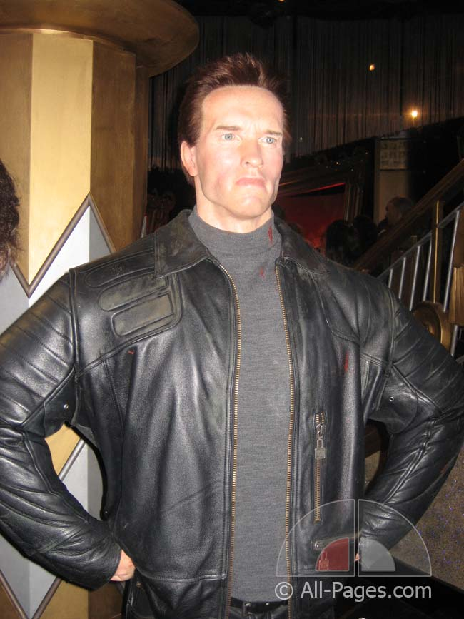
ARNOLD SCHWARZENEGGER

Slide 16
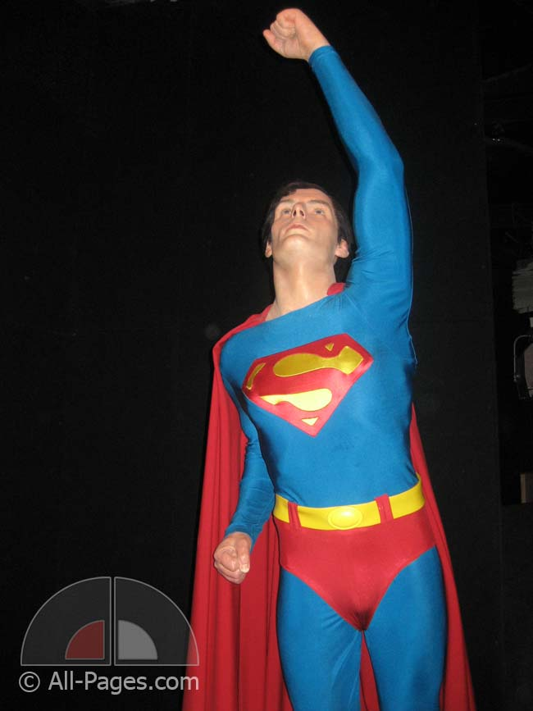

Slide 17
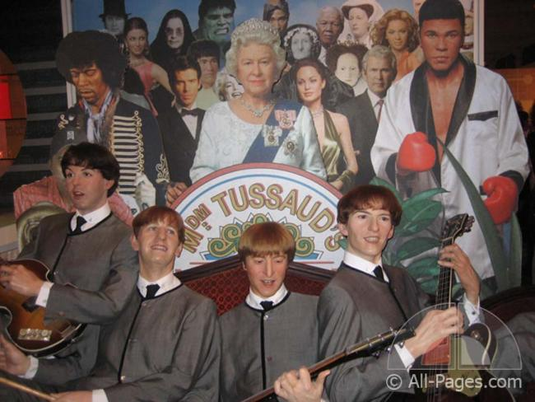
THE BEATLES

Slide 18
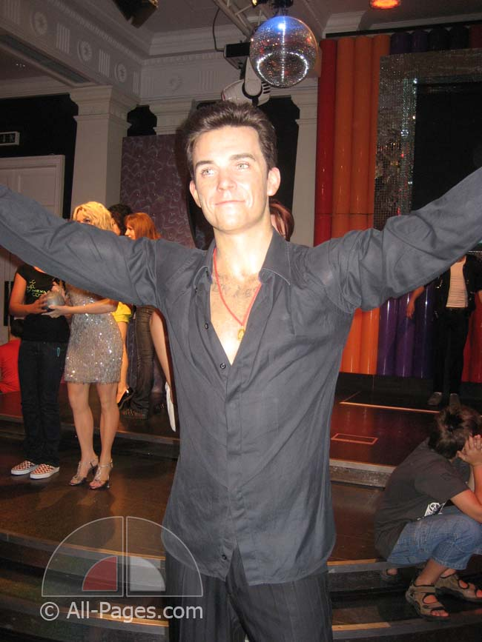
ROBBIE WILLIAMS

